Slide 1
Chicago Crime
MIS 665 Capstone Project
Amelia Noe
Jeremy Larson

Slide 2
Project Specifications
Project Description
Data Sources
To provide local law enforcement, local government, and community members key indicators for various types of crimes in Chicago and a means to predict crime in the future.
The analysis will focus on different socioeconomic variables in an attempt to diagnosis the population and different service requests recorded by the city to diagnosis city infrastructure and upkeep to see if any of these variables are useful in explaining and predicting crime in the Chicago region.
Chicago Crime:
Kaggle
Socioeconomic data:
University of Illinois at Chicago
City infrastructure reports:
Chicago Data Portal
Chicago Community Area 2010 Census:
City of Chicago
Chicago Community Area Geoshapes:
Chicago Data Portal
Crime National Incident-Based Reporting System:
Federal Bureau of Investigation

Slide 3
Community Area Analysis

Slide 4
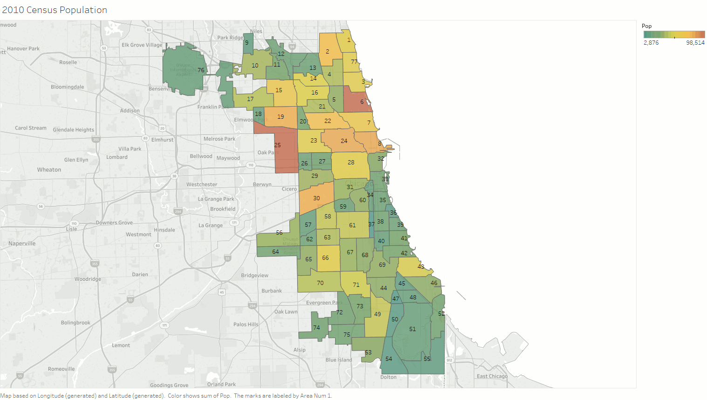
Data Community Area Visualization
The city of Chicago is split into 77 Community Areas.
Analysis for this project is based on community areas.
Notable Findings:
South and west Chicago tend to have lower socioeconomic standing than east and north Chicago.
South and west Chicago tend to have more cases of infrastructure degradation than east and north Chicago.
Areas with higher per capita income have higher rates of property crime than other areas where as areas with lower per capita income tend to have higher rates of person and/or society crime.

Slide 5
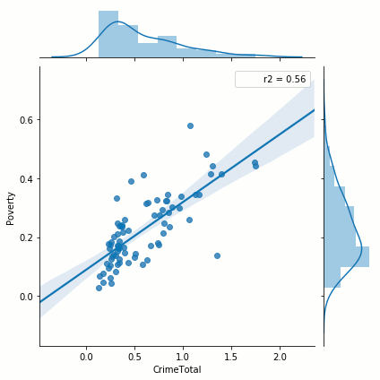
Exploration of Variables by Community Area
Evaluation of the different variables in the dataset indicated that different variables were better indicators of for different crime types.
The most promising variables were identified as:
% of households living below the federal poverty level
% of persons aged 16 years or older in the labor force that are unemployed
# of vacant buildings reports per capita
# of street lights out reports per capita

Slide 6
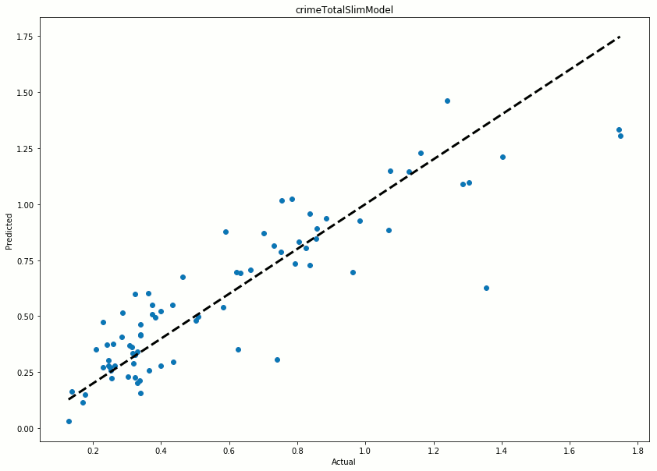
Linear Regression by Community Area
Linear regression was conducted for each type of crime and crime overall.
Each type of crime has its own unique mix of variables that are useful for modeling.
The four variables identified in the data exploration phase did prove to be impactful for nearly every type of crime however.
Linear regression model was able to achieve adjusted R-squared value of 0.774 for total crime.
Crime against people modeling achieved an adj. R-squared value of 0.893.
Crime against property modeling achieved an adj. R-squared value of 0.645.
Crime against society modeling achieved an adj. R-squared value of 0.567.

Slide 7
Conclusions on Community Area Analysis
Through the use of combining socioeconomic data on the population and 311 calls to the city of Chicago that may indicate city infrastructure degradation/blight (a.k.a. the bad part of town) and using that data in an attempt to predict crime in the city of Chicago it is the opinion of this team that we have been able to accomplish our goal with varying levels of success depending on the type of crime we are trying to predict.
There is still room for secondary research in order to improve the crime against property and crime against society algorithms.
Improving the prediction power of either of these types of crime will also improve the algorithm for total crime as well.
The adjusted R-squared for crime against people is already very high and would not be as high of a priority as improving the regression models for the other types of crime.
This group acknowledges that the individual indicators for city blight may represent "correlation may not equate causation" and it would likely be better to develop a score system to measure the degree of degraded infrastructure. Doing so was not accomplishable in the timeframe given for this project.

Slide 8
Time Series Analysis

Slide 9
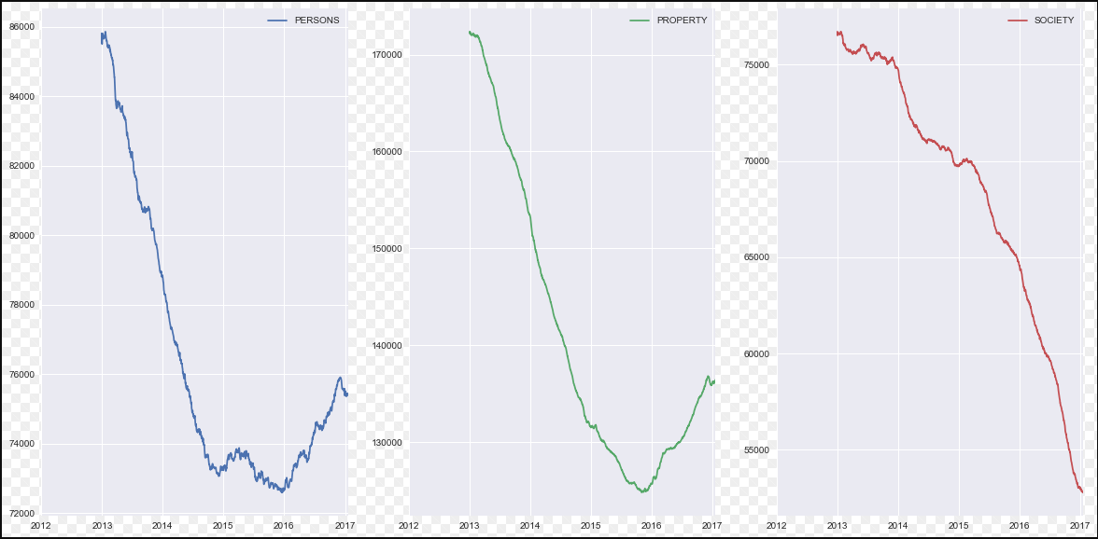
Crime Types over Years
Analysis showed that crimes against Society are steadily declining. Crimes against persons and property crimes experienced steady decreases through 2016, however they appear to be on the rise.

Slide 10
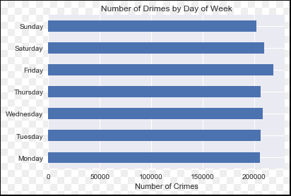
Crime Trends by Day
Analysis showed that most crimes appear to occur on Fridays and Saturdays, but not by a significant amount.
The number of crimes committed on Mondays, Tuesdays, Thursdays, and Sundays is nearly identical.

Slide 11
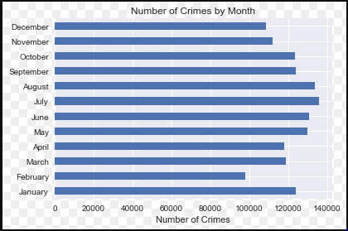
Crime Trends by Month
Crime appears to occur more frequently in the Summer months.
Crimes appear to be significantly lower in February in comparison to other months. This could be due to all the love in the air during the month of St. Valentine, but this is merely a theory. It may also be due to February being a shorter month. More detailed data is needed for precise correlation of these indicators.

Slide 12
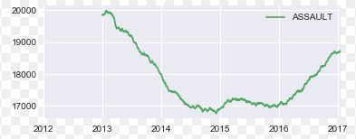
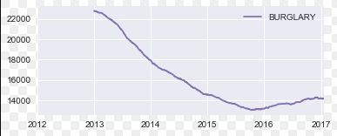
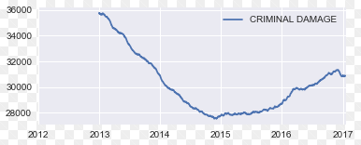
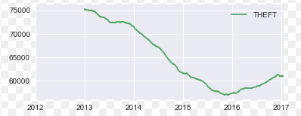
Trends in Crime Types
There were steady decreases in assault, burglary, criminal damages, and theft until 2016 when these crimes began to go on the rise.

Slide 13
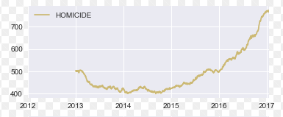
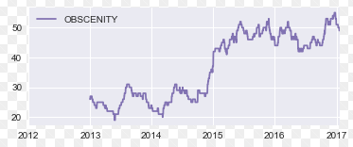
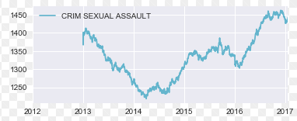
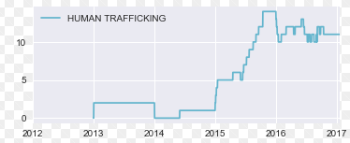
Trends in Crime Types
Some of the most significant increasing crime trends occurred in homicides, obscenities, sexual assault, and human trafficking.

Slide 14
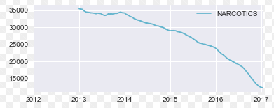
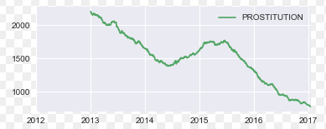
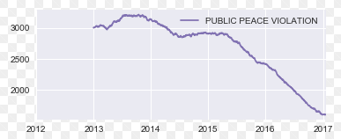
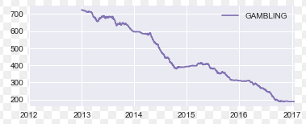
Trends in Crime Types
Crimes in narcotics, prostitution, public peace violations, and gambling showed decreasing trends without any upward movement in 2017 so far.

